Slide 1




The GENIUS Team
Luca Spogli (PI)
Ingrid Hunstad
Claudio Cesaroni
Lucilla Alfonsi
Vincenzo Romano
luca.spogli@ingv.it
RiS-ID 11174
SIOS Polar Night Week
Longyearbyen
14-18 January 2019

Slide 2

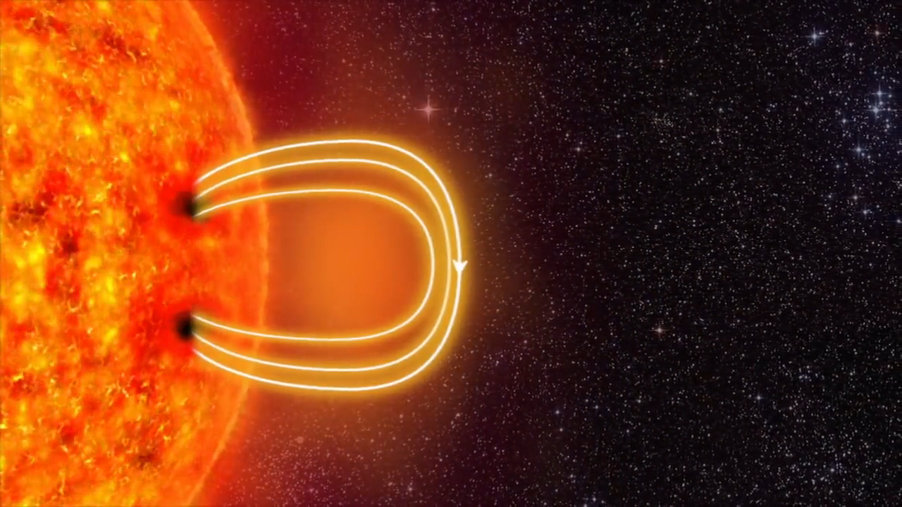
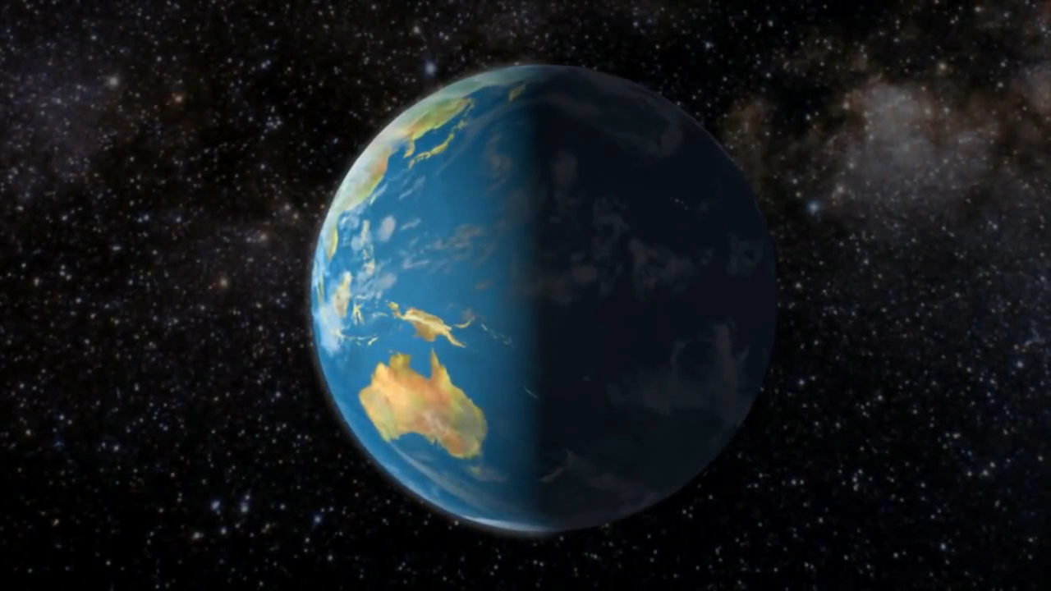
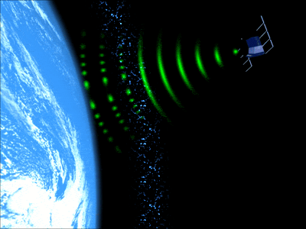


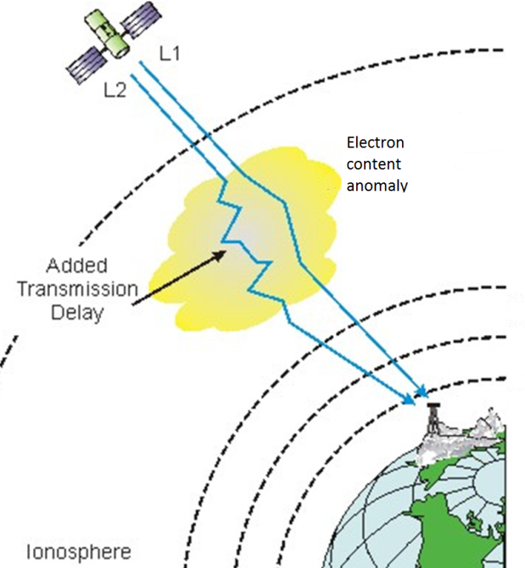
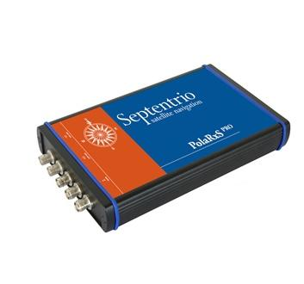



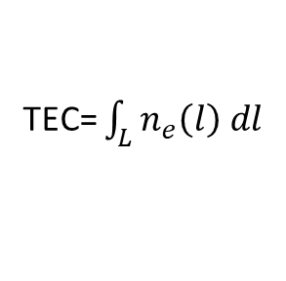
Scientific background: studying ionospheric irregularities with GNSS
The formation of ionospheric irregularities at high latitudes is driven by the forcing from the geospace
Ionospheric irregularities,
i.e.
Scintillation: phase and amplitude sudden fluctuations of the trans-ionospheric e.m. wave
Diffraction and refraction of trans-ionospheric e.m. waves
Fluctuations of ambient electron density Δn_{e}
Reduced accuracy of positioning
GNSS*
Loss of lock with the satellite
HOW TO STUDY IONOSPHERIC IRREGULARITIES:
Radio signals carry memory of the ionosphere portion they cross.
*Global Navigation Satellite System (e.g. GPS, Galileo)
Scintillation indices
Total Electron Content
TEC= $\int_{L}{n_{e}\left(l\right) dl}$
INGV contributed to the PolaRxS development in the frame of CIGALA project (funded by FP7, ended Jan 2012)
Amplitude
50 Hz sampling
1-min values
Phase
SIOS Polar Night Week
Longyearbyen
14-18 January 2019
GENIUS
luca.spogli@ingv.it

Slide 3
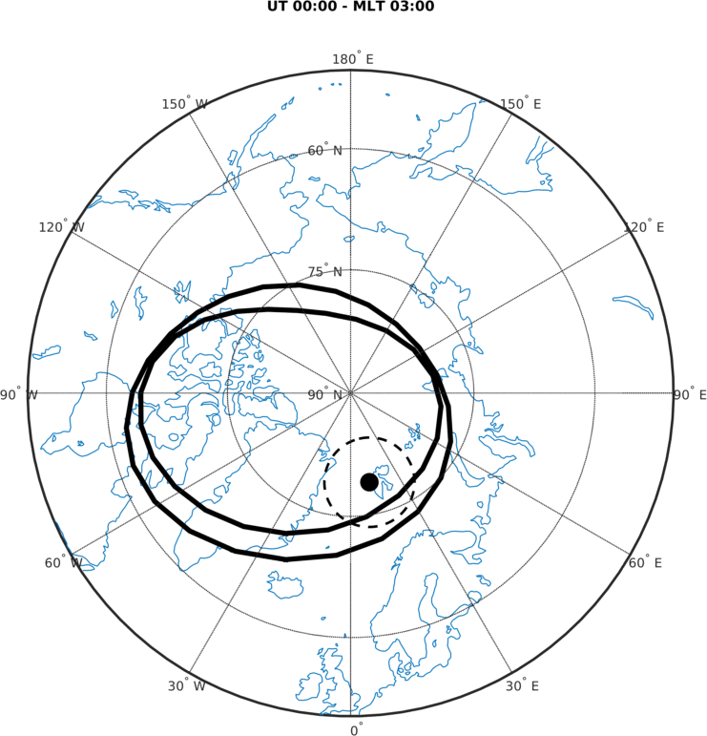
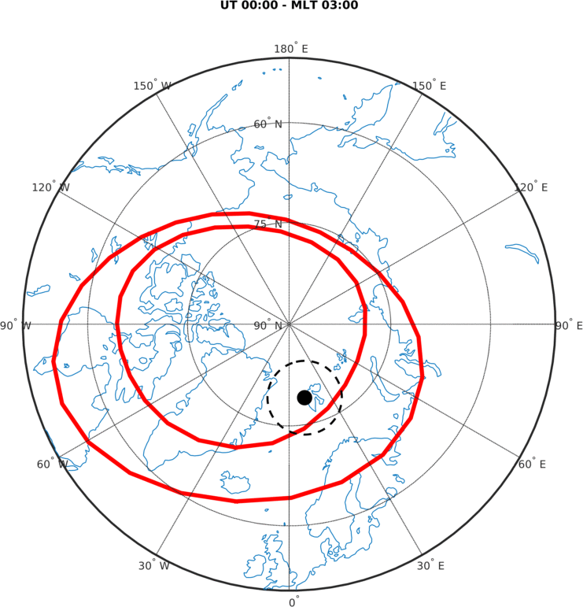
Scientific background: studying ionospheric irregularities with GNSS
Ionospheric irregularities occurr at the ovel boundaries, cap, cusp and magnetic midnight sectors
Quiet conditions IQ = 0
Disturbed conditions IQ = 6
Feldstein, Y. I, 1963
Holzworth, R. H. and Meng, C., 1975
Svalbard are the perfect sites to study scintillations in the auroral/cusp/cap regions
SIOS Polar Night Week
Longyearbyen
14-18 January 2019
GENIUS
luca.spogli@ingv.it

Slide 4
Aims of the GENIUS project
Supporting the GCI-Cusp rocket experiments with detailed regional information on the ionospheric structuring (TEC spatial and temporal gradients) and on the scintillation occurrence.
Upgrading the existing network of TEC and scintillation monitors to enable a GNSS multi-constellation observation of the ionospheric irregularities.
Contributing to the long-term monitoring of TEC and scintillation over Svalbard, operating since late September 2003.
  Produced datasets contribute to SIOS/SESS/observing system
GCI Cusp aims at determining the multi-scale physics of heating and charged particle precipitation in the ionosphere specific to the geomagnetic cusp region.
SIOS Polar Night Week
Longyearbyen
14-18 January 2019
GENIUS
luca.spogli@ingv.it

Slide 5
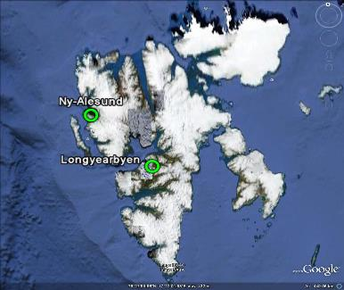
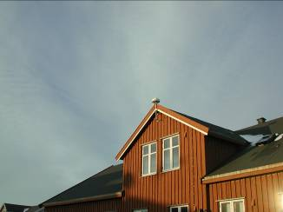

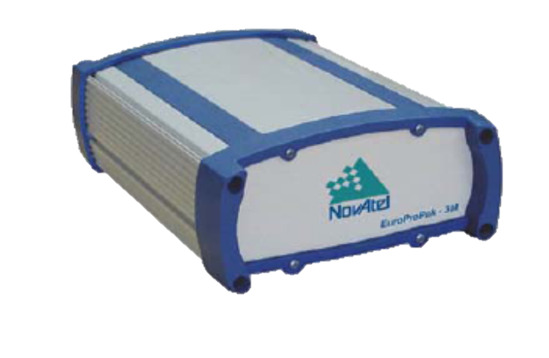
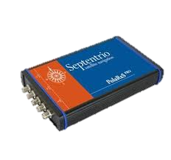
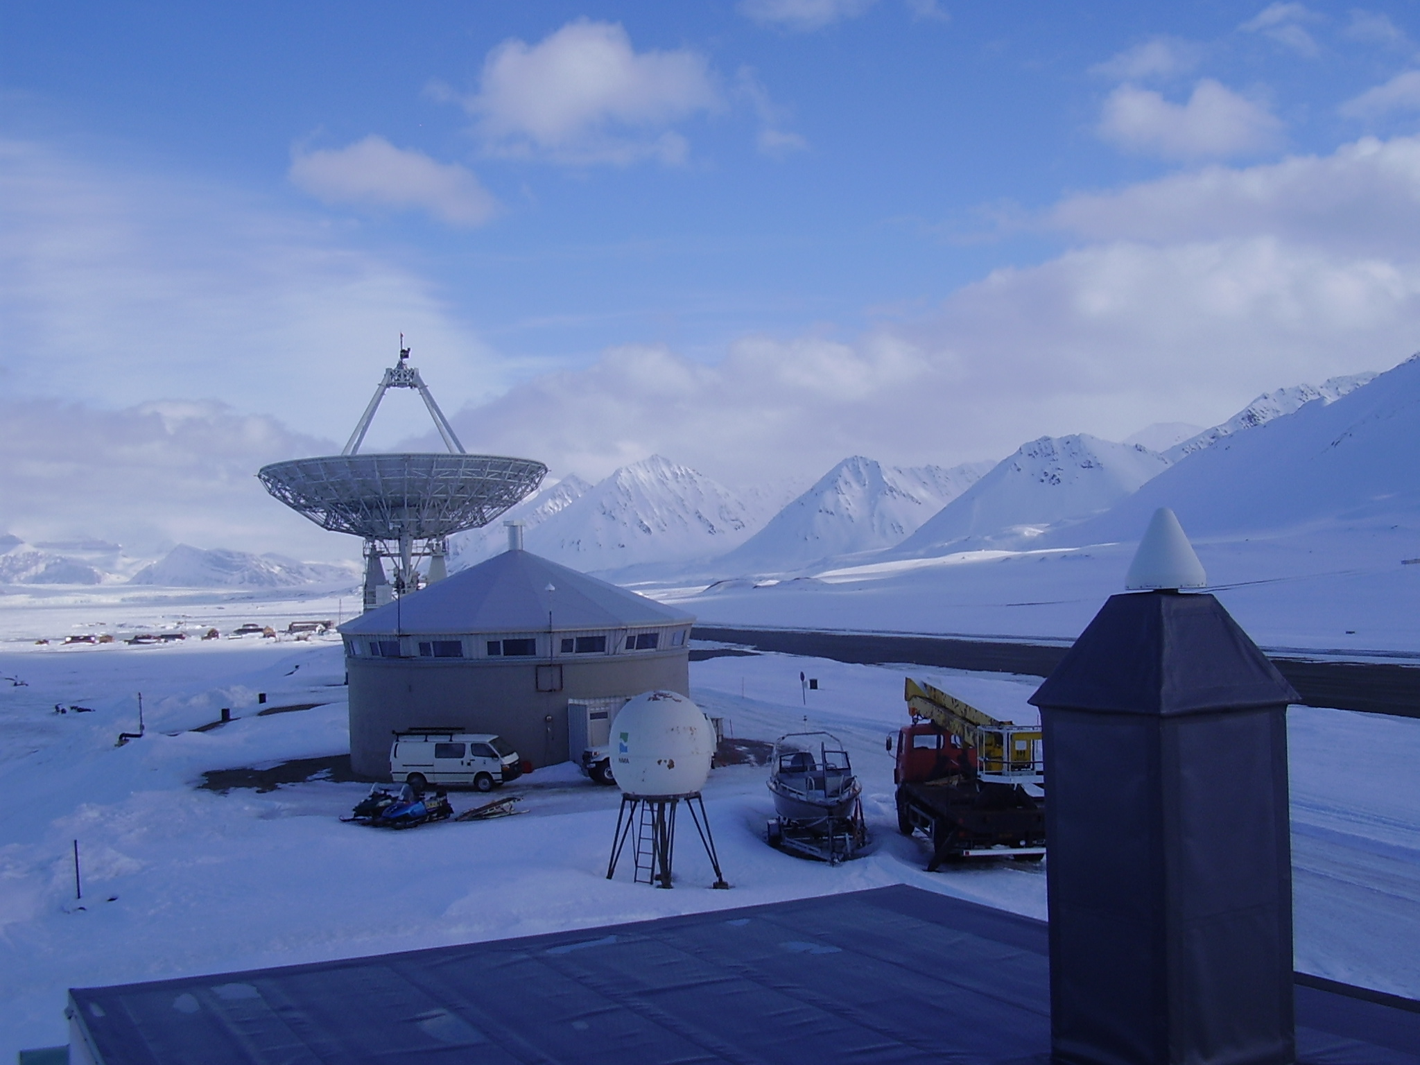
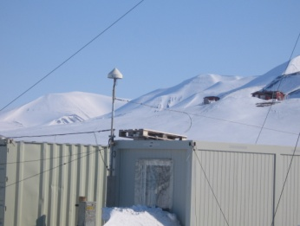
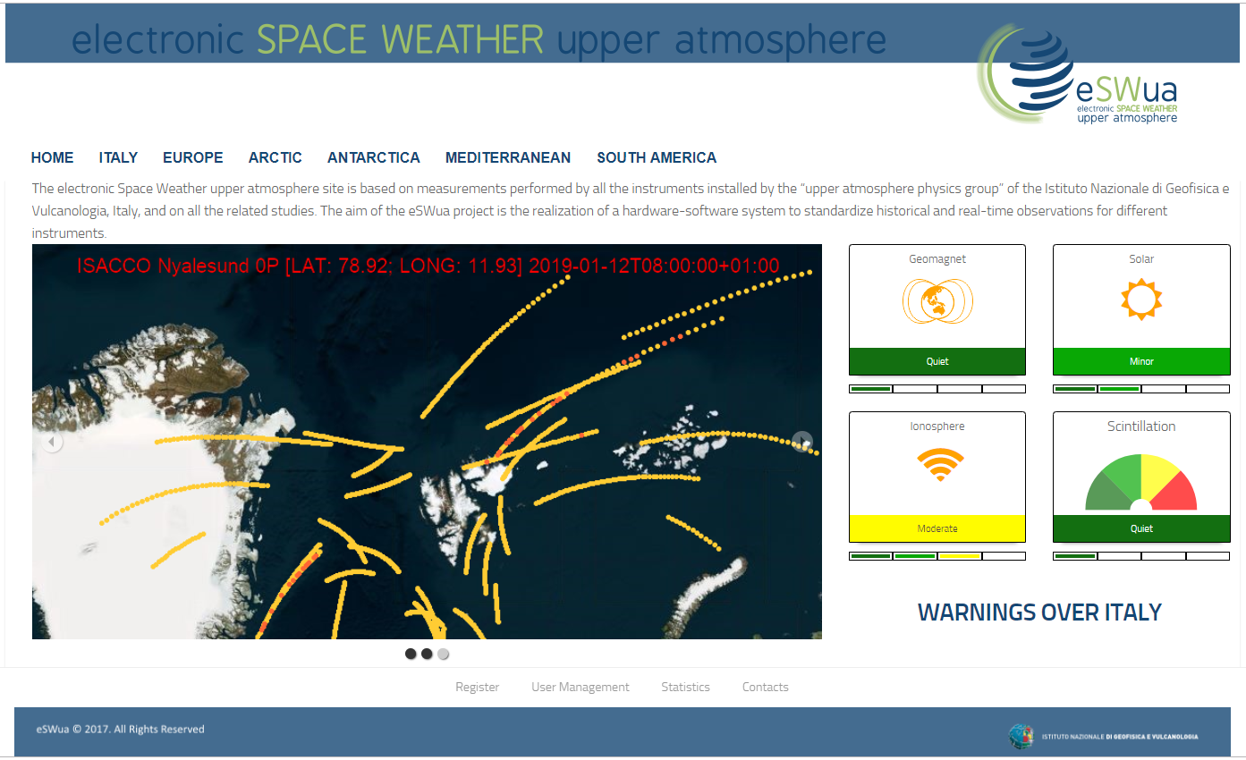
The INGV network of GNSS for scintillation and TEC monitoring
ISACCO
Ionospheric Scintillations Arctic and Antarctic Coordinated Campaign Observation
RiS-ID 3297, led by INGV - Giorgiana De Franceschi
Dirigibile Italia Station
GSV4004 scintillation data since 9/2003
PolaRxS data since November 2015
Kartverket
Adventalen
Station ID | Site | Type | Note
NYA0S | Ny-Ålesund – Dirigibile Italia Station | GSV4004B | To be dismantled within GENIUS
NYA0P | Ny-Ålesund – Dirigibile Italia Station | PolaRxS
NYA1S | Ny-Ålesund – Kartverket/VLBI | GSV4004B
LYB0S | Longyearbyen - Adventdalen | GSV4004B | To be replaced with a PolaRx5S within GENIUS
Data available in near real-time (15 min delay) in the INGV ionospheric data repository:
http://www.eswua.ingv.it - www.spaceweather.it
SIOS Polar Night Week
Longyearbyen
14-18 January 2019
GENIUS
luca.spogli@ingv.it

Slide 6
Contribution to SIOS
GNSS data within GENIUS/ISACCO have been classified by SIOS at the highest priority (1, gold) - SIOS optimisation report (pag. 35).
GENIUS project gives importance to the studies addressing the upper atmospheric layers as part of the Earth System, their contextualization in the Sun-Earth connections and in the coupling between ionized and neutral atmosphere.
Analysis conducted within GENIUS will also leverage on satellite observations provided by satellites orbiting in the polar areas (e.g. Swarm constellation by ESA).
Leveraging also on ISACCO, GENIUS will contribute to the extensive infrastructure in place in Svalbard to undertake long-term measurements of the upper ionised atmosphere.
SIOS Polar Night Week
Longyearbyen
14-18 January 2019
GENIUS
luca.spogli@ingv.it

Slide 7
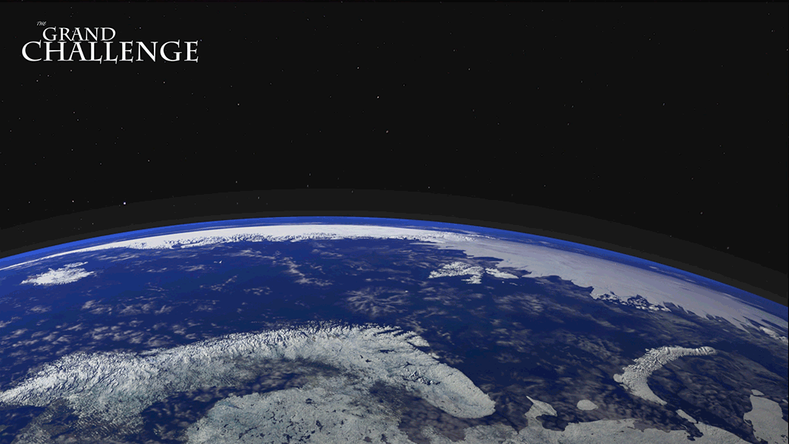
Scientific highlights: interaction with GCI-Cusp experiment
Interaction with GCI-cusp scientific board (mainly Jøran Moen from UiO) to support rocket launches in 2019 (and late 2018).
Common data analysis strategy to support rocket observation from ground and a possible tuning of the IMSR data acquisition.
Upgrade of the receiver in Longyearbyen: multiconstellation capability (larger field of view).
Dataset corresponding to launches will be made available to the GCI-Cusp community.
A common data format and a suitable mean of sharing will be also agreed.
JAXA SS-520 (Ny-Ålesund, Svalbard, Jan 2020)
AZURE (2X BB XI) – Andøya, Norway, Apr 2019)
TRICE-2 (2x BB XII – Andøya, Norway, Dec 2018)
VISIONS-2 (2x BB X – Ny-Ålesund, Svalbard, Dec 2018)
CAPER-2 (BB XII – Andøya, Norway, Jan 2019)
ICI-5 (Ny-Ålesund, Svalbard, TBD( JAN 19 or DEC 19 ) )
C-REX-2 (BB XII – Andøya, Norway, Nov/Dec 2019)
G-CHASER (Andøya, Norway, Jan 2019)
CHI(BB IX - Ny-Ålesund, Svalbard, Nov/Dec 2019)
SIOS Polar Night Week
Longyearbyen
14-18 January 2019
GENIUS
luca.spogli@ingv.it

Slide 8
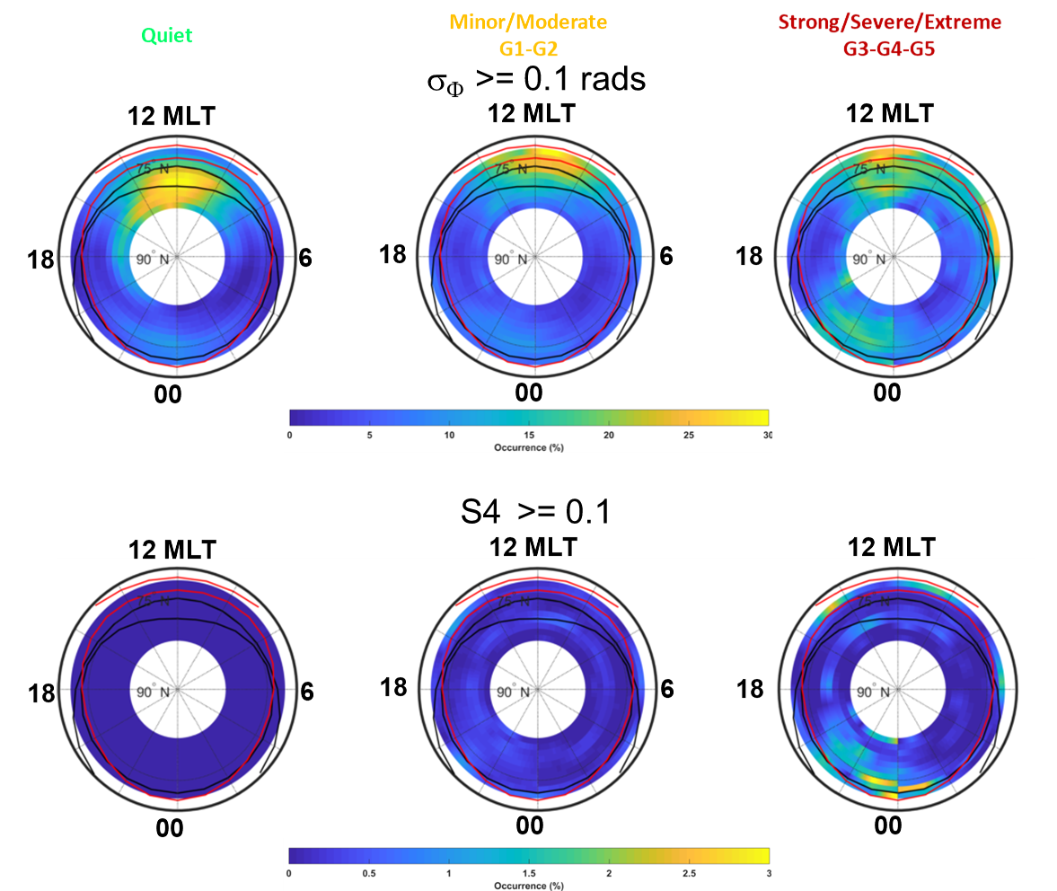
Scientific highlights: scintillation climatology over more than a solar cycle
Pha
De Franceschi et al.
Under revision in Scientific Reports (Nature)
SIOS Polar Night Week
Longyearbyen
14-18 January 2019
GENIUS
luca.spogli@ingv.it

Slide 9
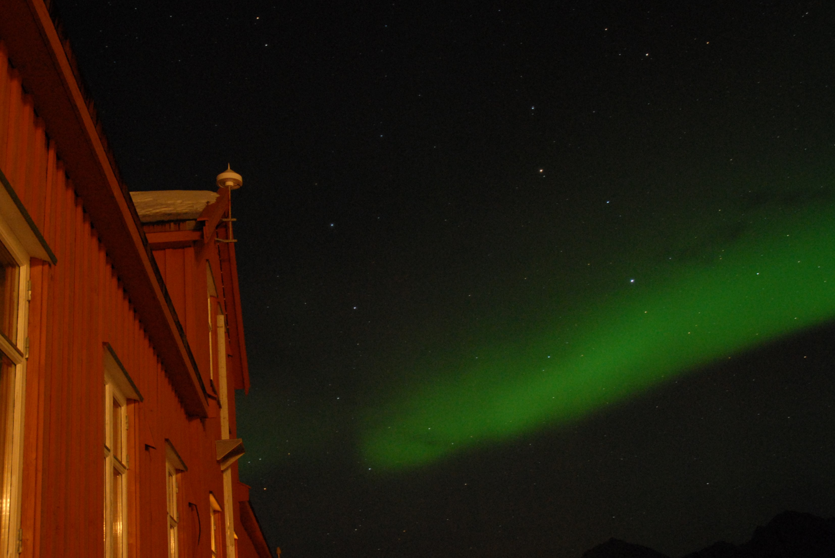
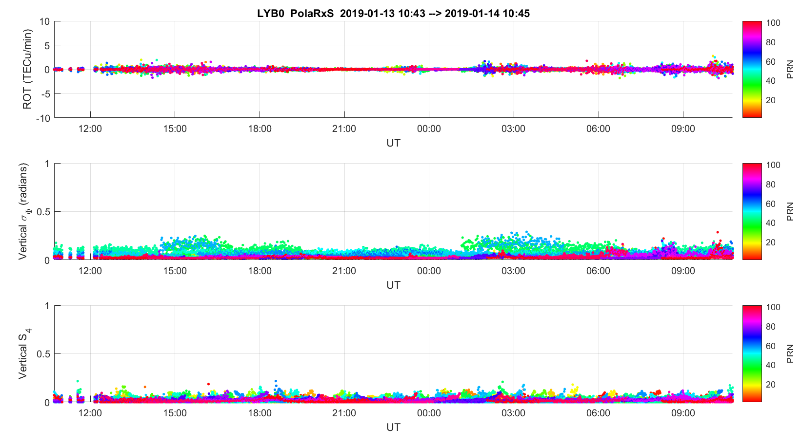
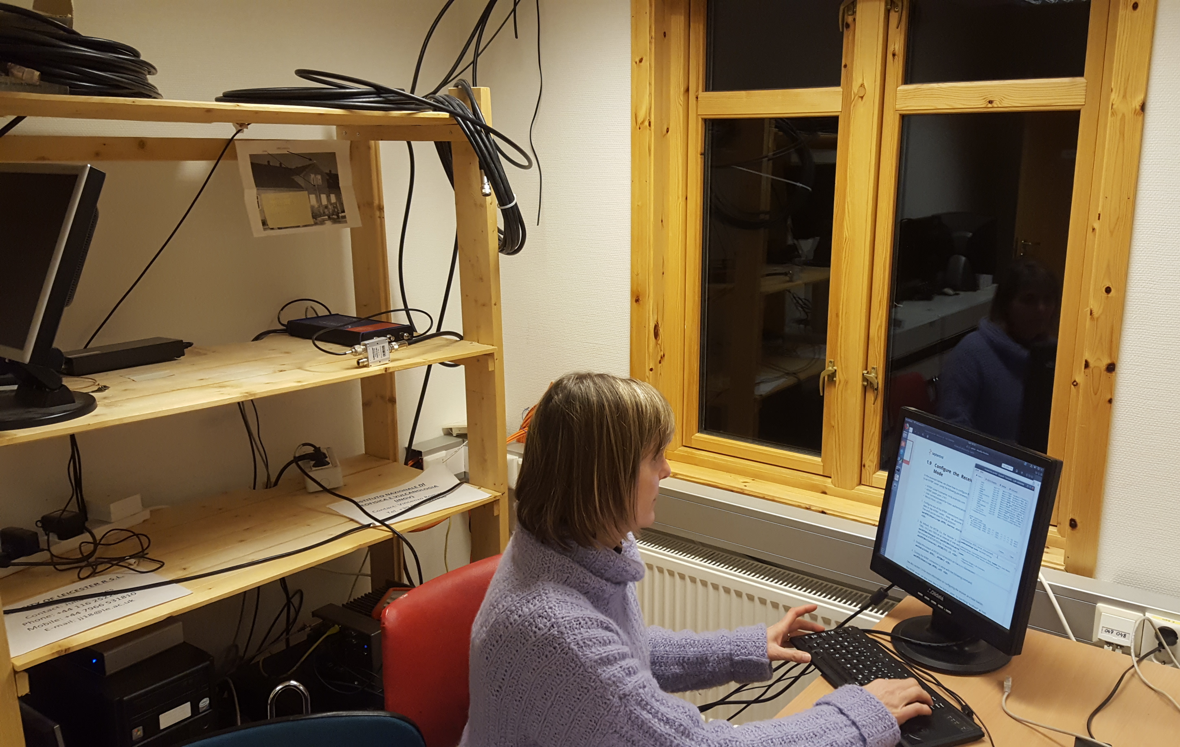
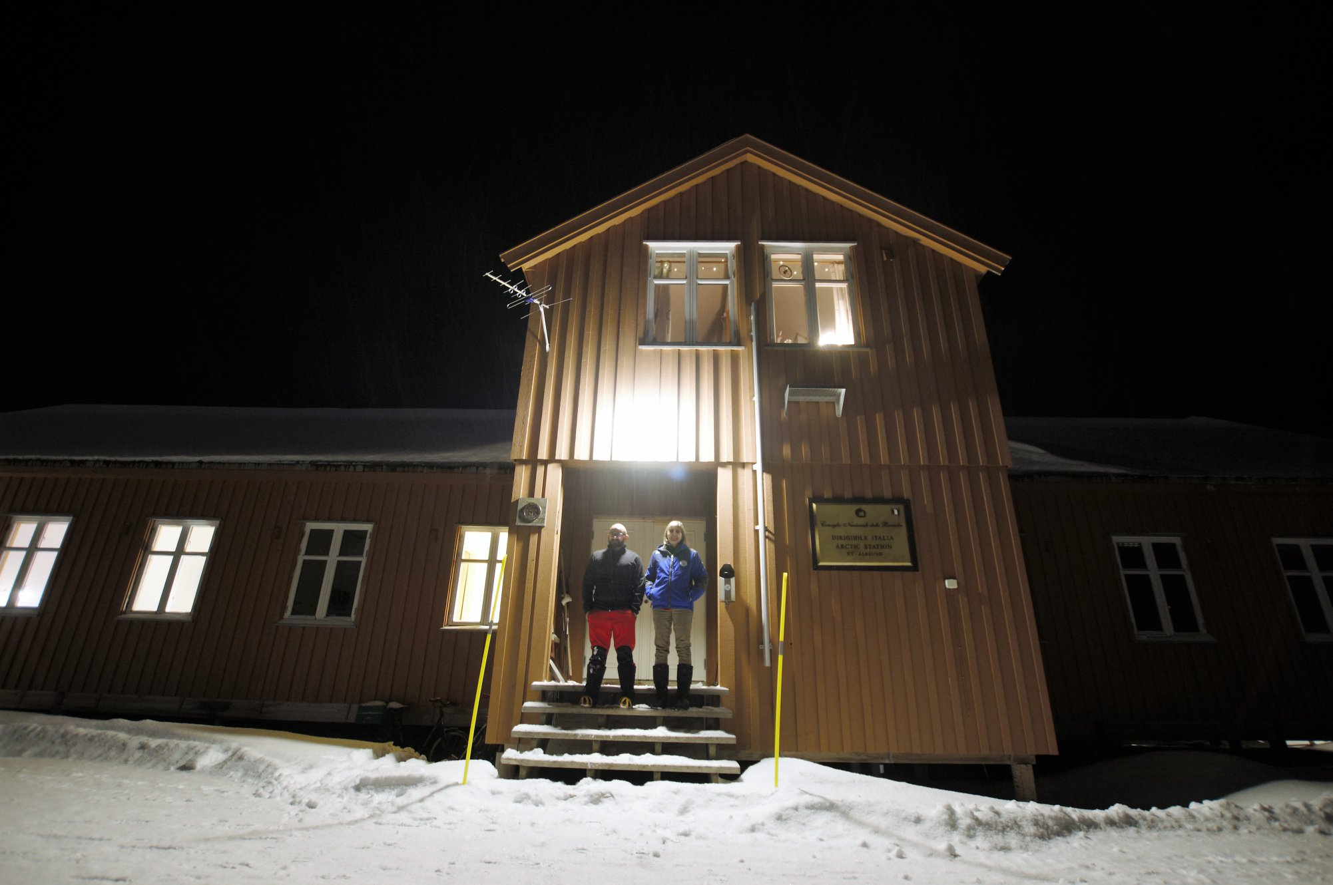
Ongoing experimental campaign
The campaign is currently ongoing.
Activities in just Ny-Ålesund ended
Activities in Longyearbyen are about to finish. The new multiconstellation receiver provides the new datasets to eSWua database
New activities in LYB and NYA: setting-up of data streaming to support nowcasting in very real-time applications (see PECASUS and IPS projects later on)
First LYB0P Multiconstellation data
Station ID | Site | Type | Note
NYA0S | Ny-Ålesund – Dirigibile Italia Station | GSV4004B | To be dismantled within GENIUS
NYA0P | Ny-Ålesund – Dirigibile Italia Station | PolaRxS
NYA1S | Ny-Ålesund – Kartverket/VLBI | GSV4004B
LYB0S | Longyearbyen - Adventdalen | GSV4004B | To be replaced with a PolaRxS (→ LYB0P)
SIOS Polar Night Week
Longyearbyen
14-18 January 2019
GENIUS
luca.spogli@ingv.it

Slide 10
International collaborations and context (1/2)
INGV has a long-lasting collaboration with the group led by Dr. Jøran Moen (Department of Physics, University of Oslo), PI of the GCI Cusp experiment.
INGV has a contract for the housing of the NYA1 receiver with the Arctic University of Norway, Tromsø Geophysical Observatory signed by Prof. Chris Hall (Observatory Leader, Faculty of Science and Technology) and John Arne Opheim (Director of the Faculty of Science and Technology).
The INGV’s ISMR in Longyearbyen is hosted in Adventdalen,where the Sousy Svalbard Radar (SSR) is operated by University of Tromsø .
In Ny-Ålesund, the GNSS station NYA1 is kindly hosted by Kartverkets geodetiske jordobservatorium.
INGV participates to the forum established to promote the creation of a new working group of the Atmosphere Research within the Ny-Ålesund Science Managers Committee (NySMAC) Flagship Programme. The nascent working group is titled “Upper atmosphere studies including aurora studies” (nysmac.npolar.no/research/flagships/atmosphere.html) and is led by Dr. Jean Lilensten (Institut de Planétologie et d'Astrophysique de Grenoble) and by Dr. Linnea Andalsvik (Norwegian Mapping Authority).
The GENIUS project will interact also with the TREASURE (Training REsearch and Applications Network to Support the Ultimate Real-Time High Accuracy EGNSS Solution) project, a H2020 Marie Skłodowska-Curie Innovative Training Network (www.treasure-gnss.eu).
SIOS Polar Night Week
Longyearbyen
14-18 January 2019
GENIUS
luca.spogli@ingv.it

Slide 11





International collaborations and context (2/2)
INGV at SCAR Scientific Committe for Antarctic Research
http://www.grape.scar.org/
Italy (INGV) leads the SCAR expert group called GRAPE (GNSS Research and Application for Polar Environment). GRAPE is a joint GeoSciences and Physical Sciences Expert Group lasting from 2012 to 2018. Eleven countries are involved.
PI: Giorgiana De Franceschi – INGV
RESOURCE (Radio Sciences Research on AntarctiC AtmospherE) is a proposed scientific research programme. Investigation of the atmosphere by means of radio observation. Remove or to mitigate the atmospheric noise from their radio measurements. PI: Lucilla Alfonsi (INGV) and Nicolas Bergeot (ROB).
INGV (and Italy) at ICAO
PECASUS
INGV, in collaboration with ENAC (the Italian Civil Aviation Authority), is member of an European consortium (leader: Finnish Met Institute) to be one of the global space weather centers providing support to ICAO for international air navigation
IPS - Ionosphere Prediction Service
Ionosphere Prediction Service (IPS) is a project funded by EU Commission led by Telespazio (IT). Prototype capable to provide several alert and forecasting ionospheric products addressed to GNSS users and Service Providers.
www.ips.telespazio.com
SIOS Polar Night Week
Longyearbyen
14-18 January 2019
GENIUS
luca.spogli@ingv.it

Slide 12
Training of young scientists/Public outreach
INGV Researchers are lecturers of the
Space Weather PhD Course at Roma Tre University
Master Course on Telecommunication at Politecnico
Masters in Sustainable Development, Resources Geopolitics and Arctic Studies at the Italian Society for International Organization.
Summer schools related to Sun-Earth relationships and Space weather.
PhD students with secondments in UiO
INGV is involved in the outreach activities of the European Researchers Night and the outcome of the GENIUS project will be disseminated in the events organised by INGV in such framework.
http://ec.europa.eu/research/mariecurieactions/about/european-researchers-night_en
SIOS Polar Night Week
Longyearbyen
14-18 January 2019
GENIUS
luca.spogli@ingv.it

Slide 13
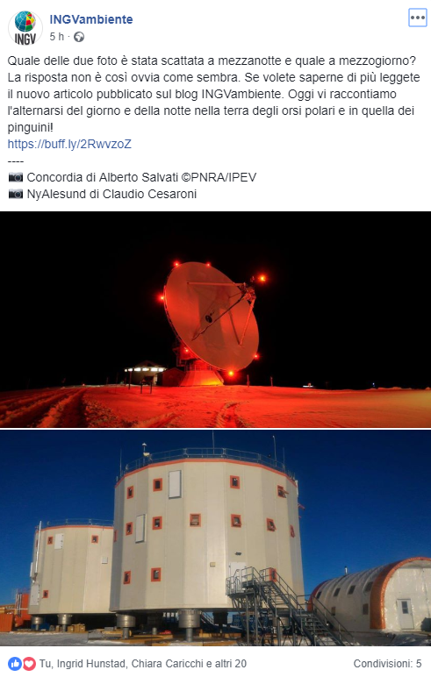
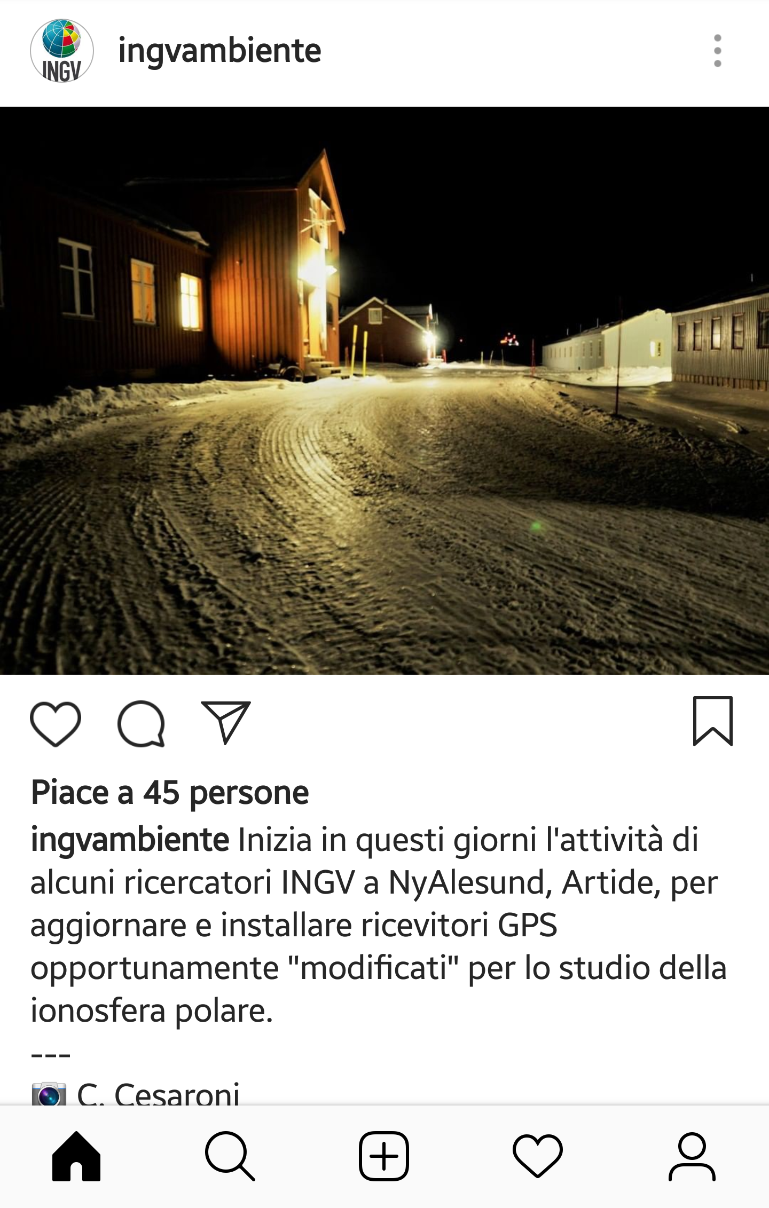





Training of young scientists/Public outreach
Blog INGV Ambiente
https://ingvambiente.com
SIOS Polar Night Week
Longyearbyen
14-18 January 2019
GENIUS
luca.spogli@ingv.it

Slide 14
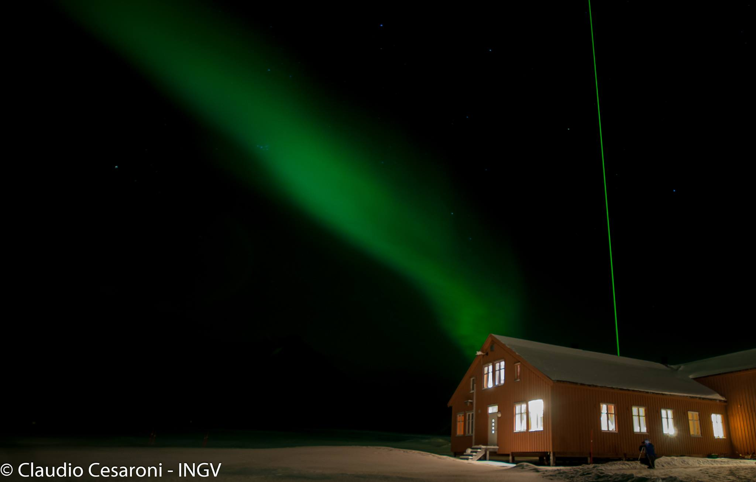
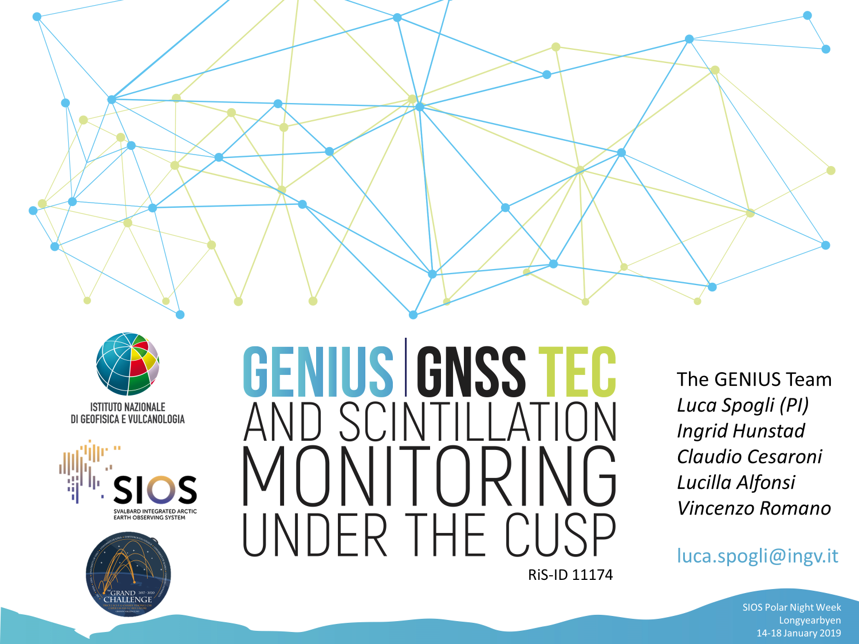
Many thanks for your attention!
Aurora over Dirigibile Italia Station – 10 Jan
Many thanks to the CNR friends
SIOS Polar Night Week
Longyearbyen
14-18 January 2019
GENIUS
luca.spogli@ingv.it

